Slide 1
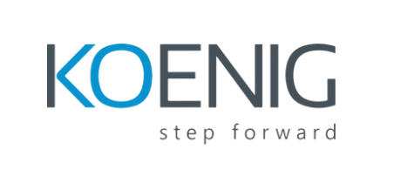
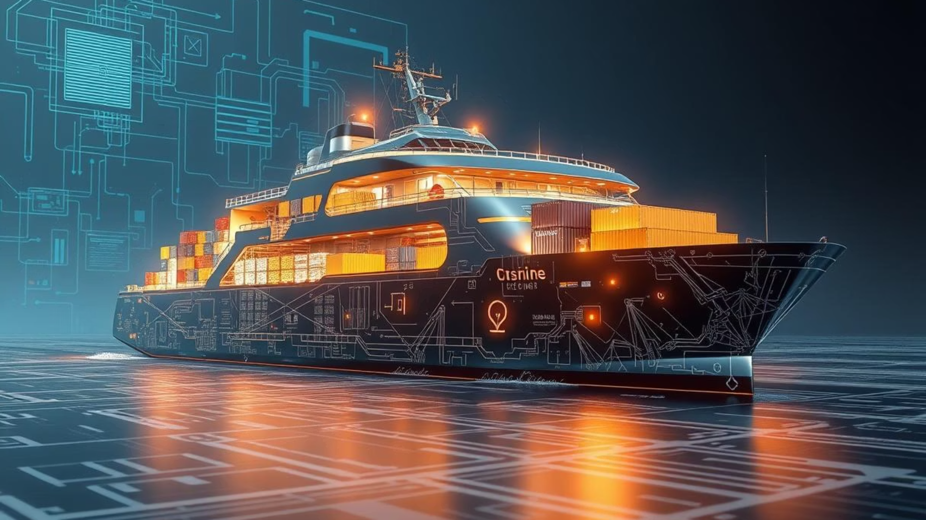
Building Better Docker Images
Practices for Production-Ready Containers
Processed by PPT Studio
Notes:
**Option 1 (Focus on Best Practices):**
> This slide introduces our section on building better Docker images. We'll be discussing key practices for creating production-ready containers, focusing on efficiency, security, and maintainability.
**Option 2 (Highlighting the 'How'):**
> Moving into the practical aspects. We'll explore specific techniques and strategies for crafting high-quality Docker images. The goal is to ensure they're robust and prepared for deployment.
**Option 3 (Simple & Direct):**
> Now we'll delve into best practices for building Docker images ready for production.
**Key Considerations:**
* **Audience:** Who are you talking to? Tailor the language to their level of understanding.
* **Overall Flow:** How does this slide connect to the previous and subsequent slides?
* **Time Allotment:** How much time do you plan to spend on this section?
The best option depends on the overall context of your presentation. Choose the one that best sets the stage for the content that follows.

Slide 2
Agenda: Optimising Your Docker Workflow
In this session, we'll cover key strategies for building Docker images that are efficient, secure, and ready for production environments. We'll explore:
1
Efficiency & Size
2
Security Best Practices
3
Maintainability & Consistency
Crafting lean images for faster deployments and reduced resource consumption.
Minimising attack surfaces and safeguarding your applications.
Ensuring reliable builds across development and CI/CD pipelines.
Processed by PPT Studio
Notes:
**Speaker Note:**
* **(Intro - 15-30 seconds)** Briefly introduce the agenda and highlight the importance of optimized Docker workflows for speed, security, and reliability. Emphasize the value for audience members aiming for efficient production deployments. Briefly touch on each key area to be covered.
* **(PPT Studio - acknowledgement)** Mention that the slides have been processed by PPT Studio. (Optional - if relevant to your audience/context - briefly explain PPT Studio).

Slide 3
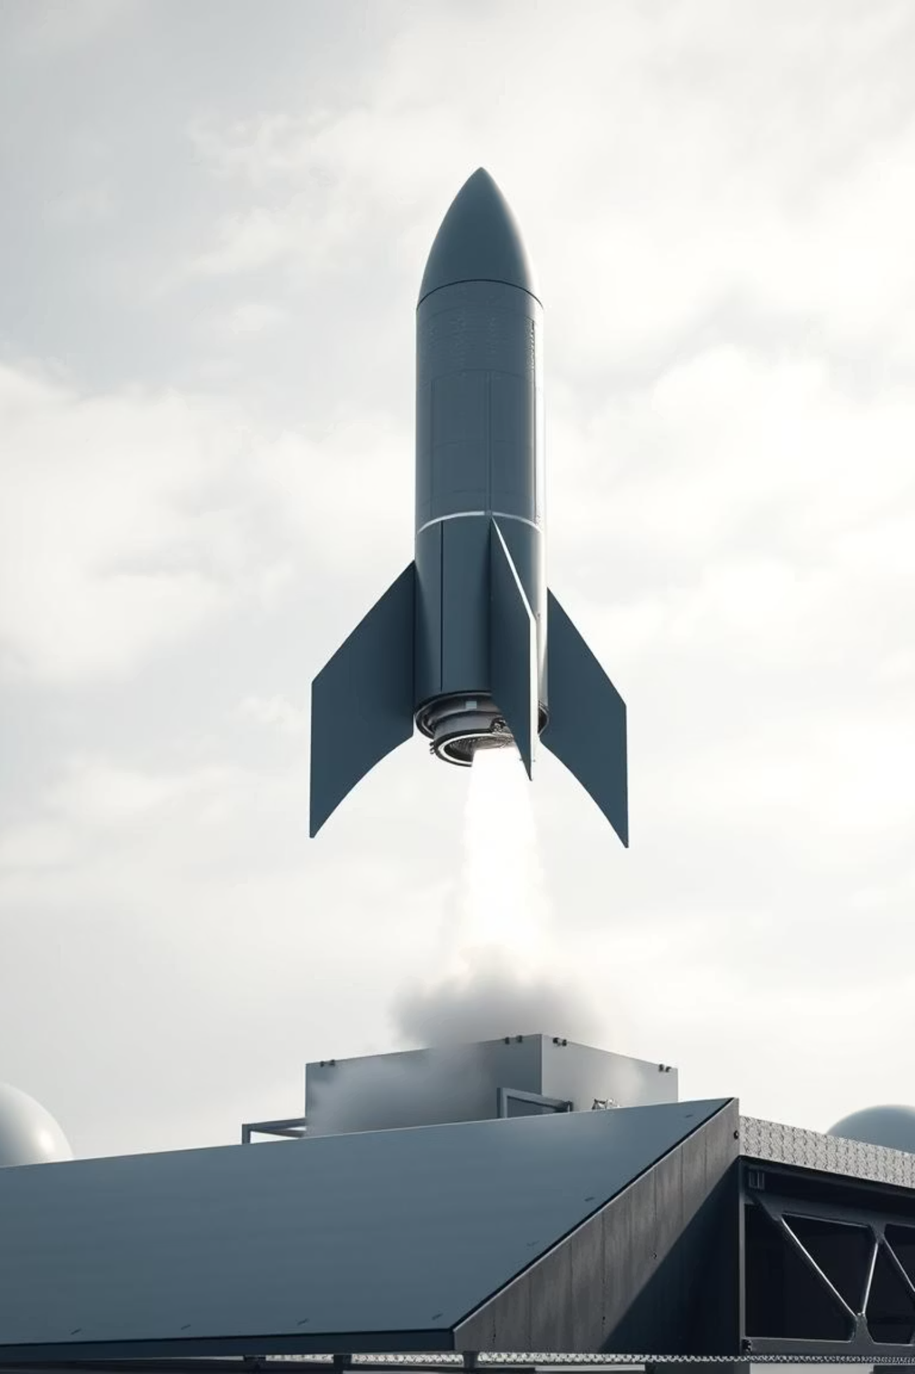
Start Lean: Minimal Base Images
The foundation of an efficient Docker image is its base. Choosing a minimal base image dramatically reduces size and potential vulnerabilities.
1
2
Alpine Linux
Debian Slim
Extremely small, designed for minimal footprints. Ideal for many applications.
A stripped-down version of Debian, offering a good balance between size and compatibility.
3
Language-Specific Variants
Many language runtimes offer slim or alpine variants (e.g., node:alpine, python:slim).
Processed by PPT Studio
Notes:
Okay, here are concise and professional speaker notes for that slide:
**Speaker Notes:**
* **Key takeaway: Start Lean!** Emphasize the importance of a minimal base image for efficient Docker builds.
* **Size & Security:** A smaller base translates directly to smaller images, faster deployments, and a reduced attack surface.
* **Options:** Briefly introduce Alpine (smallest, great for many), Debian Slim (balance of size and compatibility).
* **Language Specific:** Highlight that many language official images have prebuilt smaller variants.
* **Action:** Encourage audience to investigate smaller base image options for their own applications.
* **(Optional, if relevant):** *[If time allows] briefly mention specific tools or best practices for further reducing image size after selecting a base, such as multi-stage builds.*
**Why this works:**
* **Concise:** Gets to the point quickly.
* **Action-Oriented:** Encourages audience to think about implementation.
* **Professional:** Avoids overly casual language.
* **Prioritized:** Focuses on the most important messages.
* **Optional Expansion:** Allows for tailored elaboration if needed.

Slide 4



Multi-Stage Builds: The Golden Rule
Multi-stage builds are critical for creating small, secure, and production-ready images by separating build-time dependencies from runtime necessities.
Build Stage
Final Stage
Result
Compile your application, run tests, and generate artefacts using all necessary tools.
Copy only the compiled artefacts to a minimal base image, leaving build tools behind.
Significantly smaller image, reduced attack surface, and faster deployments.
Processed by PPT Studio
Notes:
**Speaker Note:**
"This slide highlights the core principle of multi-stage builds. Emphasize that this technique is *crucial* for creating efficient and secure container images. Briefly explain the two key stages: Build, where everything needed for compilation happens, and Final, where we cherry-pick only the essential compiled artifacts into a lean, production-ready image. Point out the three key benefits: smaller image size, smaller attack surface, and faster deployments."

Slide 5

Optimise with .dockerignore & Layer Minimisation
These two practices work hand-in-hand to ensure your Docker images are as lean and performant as possible.
Leverage .dockerignore
Minimise Layers
Combine related RUN instructions using &&.
Exclude development files (e.g., .git, node_modules, local temp files).
Each RUN, COPY, FROM command creates a new layer.
Speeds up build context transfer.
Fewer layers result in smaller images and better cache utilisation.
Prevents sensitive or unnecessary files from being added.
Processed by PPT Studio
Notes:
**Speaker Note:**
"This slide focuses on optimising our Docker images for size and performance. We'll cover two key strategies: `.dockerignore` and Layer Minimisation. First, `.dockerignore` acts like a `.gitignore` for your Docker build. It prevents unnecessary files, like `.git` folders or development dependencies, from being included in the image. This drastically speeds up build times and avoids potential security vulnerabilities. Secondly, we'll discuss minimising layers. Remember each `RUN`, `COPY`, and `FROM` instruction in your Dockerfile creates a new layer. Combining related `RUN` instructions with `&&` reduces the number of layers, resulting in smaller images and improved caching, leading to faster deployments."

Slide 6
Dependency Management & Cleanup
Consistent and clean images rely on disciplined dependency management and thorough post-installation cleanup.
Pin Dependency Versions
Clean Up After Installation
Avoid Unnecessary Tools
Always specify exact versions for packages and dependencies. This ensures reproducible builds across all environments.
Immediately remove package caches, temporary files, and build artefacts within the same RUN instruction to prevent creating unnecessary layers.
Only install what's absolutely required for the application's runtime. Use multi-stage builds to separate build-time tools.
Processed by PPT Studio
Notes:
Okay, here are a few concise, professional speaker notes for that slide, varying slightly in emphasis:
**Option 1 (Focus on Reproducibility & Size):**
> "This slide highlights the critical importance of dependency management and cleanup for creating consistent and efficient container images. Pinning dependency versions guarantees reproducible builds across different environments. Cleaning up installation leftovers immediately reduces image size and improves security. Remember to avoid installing tools not needed at runtime – leveraging multi-stage builds for build-time dependencies."
**Option 2 (Focus on Security & Best Practices):**
> "We're now discussing dependency management and image cleanup. Following these best practices is crucial for security and maintainability. Pinning versions eliminates variability and potential vulnerabilities. Cleanup minimizes the attack surface and image size. Don't forget: Only install necessary tools and use multi-stage builds to further optimize your images."
**Option 3 (More Direct & Action-Oriented):**
> "Let's talk about keeping our images lean and reliable. First, pin dependency versions – *always*. Second, clean up after package installation – *immediately*. Third, be selective about tools; use multi-stage builds to isolate build processes. This disciplined approach leads to smaller, more secure, and reproducible images."
**Key Considerations When Choosing:**
* **Audience Level:** Adapt the language to your audience's technical knowledge.
* **Presentation Flow:** Choose the option that best connects to the previous and subsequent slides.
* **Personal Style:** Use the notes that feel most natural for you to deliver.
I tried to keep all options concise and focus on the "why" behind the points, not just restating the text on the slide. Good luck with your presentation!

Slide 7
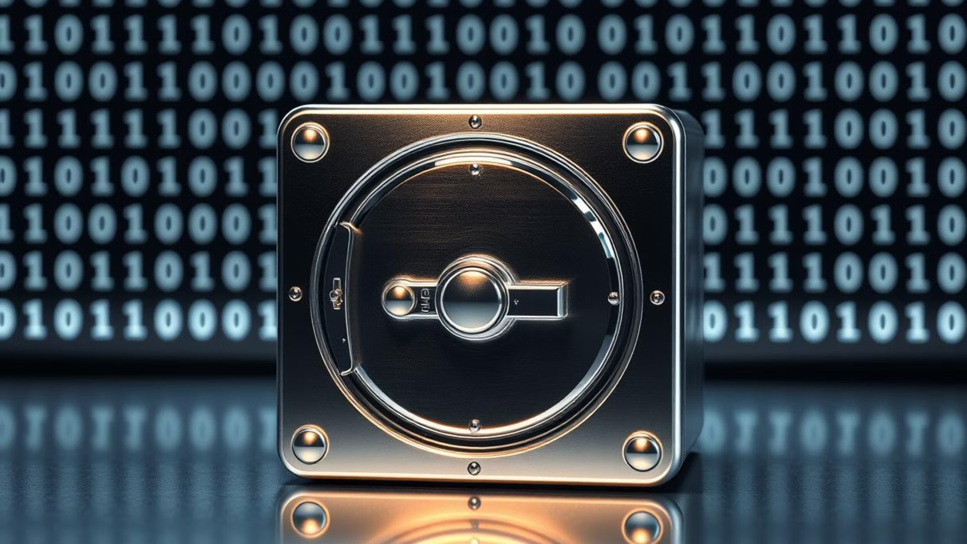
Security First: Beyond the Basics
Building secure images isn't just about reducing size; it's about minimising risk.
Processed by PPT Studio
Notes:
**Speaker Note:**
"This slide emphasizes that security is paramount in image building. We're moving beyond simple size reduction and focusing on mitigating potential vulnerabilities and hardening our images against attack. Remember, a small image isn't necessarily a secure image. We'll delve deeper into specific security best practices in the following slides."

Slide 8
Enhanced Security: User and Command Best Practices
Protecting your containers from potential exploits requires careful attention to user permissions and command usage within the Dockerfile.
Run as Non-Root User
Prefer COPY over ADD
Always switch to a non-root user using the USER directive.
COPY is simpler and more predictable, only copying local files.
Limits potential damage if a container is compromised.
ADD has additional features (URL download, tar extraction) that can introduce security risks or unexpected behaviour if not carefully used.
Example: RUN adduser --system appuser, then USER appuser.
Processed by PPT Studio
Notes:
**Speaker Note:**
"This slide focuses on enhancing container security through user and command best practices. Crucially, **run your containers as a non-root user** after installation. This limits the potential damage if a container is compromised – a huge security advantage. The example shows creating `appuser` and switching to it with `USER`. Next, **favor `COPY` over `ADD`**. `COPY` is straightforward, simply transferring files. `ADD` offers additional, potentially risky features that you often don't need and can introduce vulnerabilities. Choose `COPY` for safer and more predictable image builds."

Slide 9
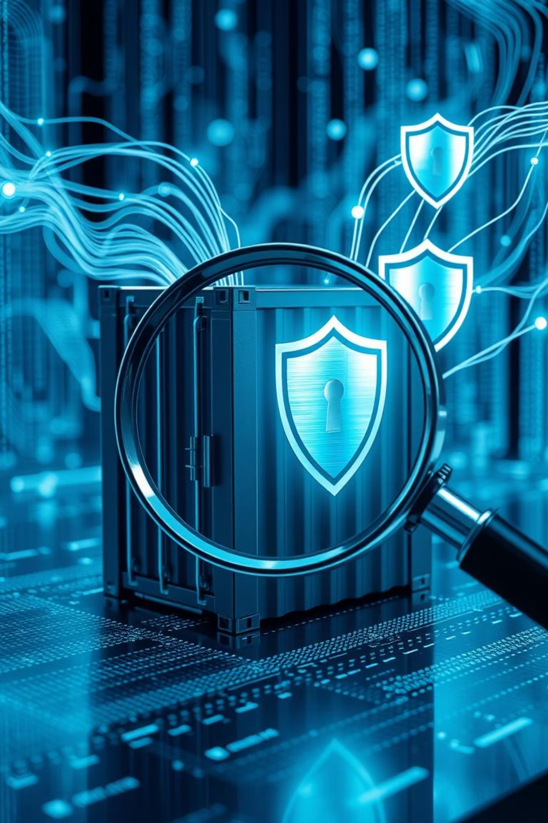
Image Scanning & CI/CD Integration
Proactive security scanning is essential for identifying and mitigating vulnerabilities throughout your development lifecycle.
Automate Scans
1
Integrate tools like Trivy, Docker Scout, or Clair into your CI/CD pipelines.
Catch Issues Early
2
Identify known vulnerabilities in dependencies and base images before deployment.
Continuous Monitoring
3
Regularly scan images even after deployment to detect newly discovered threats.
Processed by PPT Studio
Notes:
**Speaker Note:**
This slide highlights the importance of integrating image scanning into your CI/CD pipelines for proactive security. We're moving from reactive to proactive security. Key benefits include: 1) automating scans within CI/CD using tools like Trivy, Docker Scout, or Clair; 2) catching vulnerabilities early – before they reach production, reducing risk; and 3) continuous monitoring post-deployment for ongoing threat detection. This helps us shift left on security and build more secure applications from the start.

Slide 10



Key Takeaways & Next Steps
Optimise Early
Secure by Design
Integrate & Automate
Prioritise lean images from the start with minimal bases and multi-stage builds.
Implement non-root users, careful dependency management, and regular scanning.
Make image building and security a seamless part of your CI/CD workflow.
These practices are the bedrock for resilient, performant, and secure Dockerised applications.
Processed by PPT Studio
Notes:
**Speaker Note:**
"This slide summarizes our core recommendations. Remember: **Optimize Early** for smaller, faster images; **Secure by Design** for fewer vulnerabilities; and **Integrate & Automate** for efficiency. These aren't optional extras; they're *essential* for building robust and secure Docker applications that scale. Now, let's discuss *how* you can start implementing these strategies within your own teams."

